Slide 1

Changing Job Functions
Lindsay McQuade

Slide 2
Career Programme
Changing Job Functions
Job Search Strategies & LinkedIn
Off-site coding Challenge, Technical Blog & GitHub
1 Week
12 week
until the 1st job
One to one coaching (via Calendly)
CV & Cover Letter
HR Interviews & Salary
Group mock interview ( via Calendly)

Slide 3

Sources
As I mentioned today if you want to access the posts from the events & partnership team you can join the hiring channel and for channel which alumni use to post job ads you can join the job board channel .
Spiced.space has the schedule
Careers channel on slack has copies of the material
One to Ones : Lindsay (Stationary Sriracha & Unsupervised Fenugreek)
Olga Lavrenko, Costmary Function

Slide 4
Defining the job you would like to have.
Notes:
Companies? Is it possible to move from data analytics to data science? What is the culture of your company like? What is the current funding status? Startup - may work as a full stack data scientist? Corporate - can learn more. Non-profit or for profit? Structured or non-structuctured? Do you want to work for a consultancy?
Just focusing on the role is one dimensional and will not necessarily lead you to the best option. You could go to linkedin type in data something junior. Do you know how many roles will come up? Berlin x . Hamburg? What other ways can you think of that could lead

Slide 5
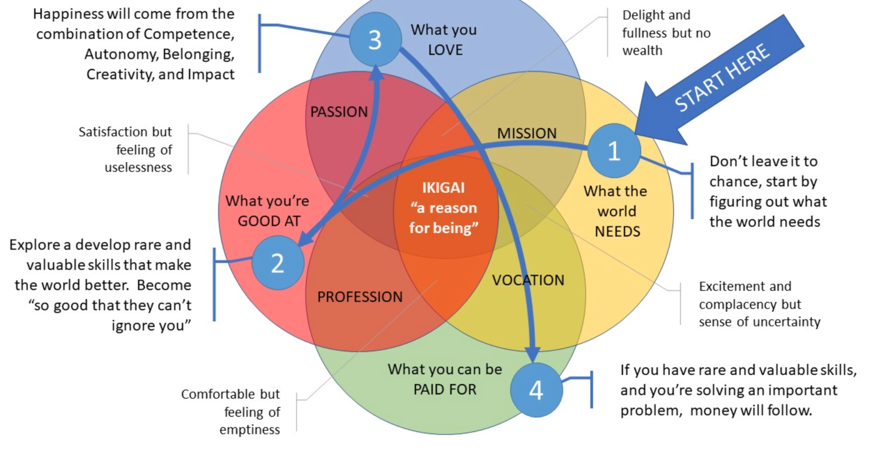
Impact and Life Purpose with IkiGai

Slide 6
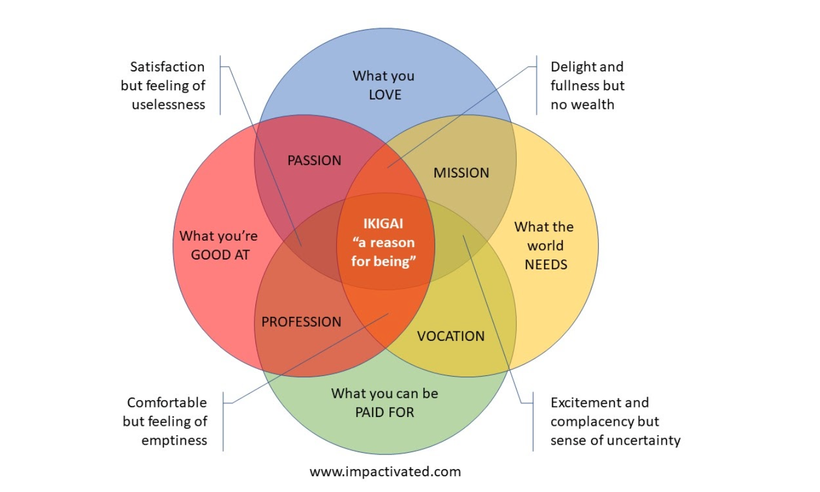
Step 1. What the World Needs?
Start with the most difficult part and make sure you don’t simply leave it to chance: find out what the world needs.
What data roles does the market have and what are the entry requirements?
How are ML or analytics being used to solve business problems in different industries/domains?
How will you find out if you are not sure?
Here is the work that you did as a group :https://jamboard.google.com/d/1ilhJ405sDlxJGtm66_cUG31E4gsH7zwhxX8wvsZIpSA/viewer?f=7

Slide 7
Step 2. What are you good at?
Figure out what you’re good at (or what you can be good at) and that can solve a problem, and in particular find a personal fit with what the world needs.
What existing technical skills are you good at that might be relevant to the data world? Statistics? Maths? Coding skills? Analytical?
What soft skills do you have that you might be relevant to data roles? Communication? Client skills ? Team working?
What emerging skills are you developing that you can become good at?
What domain/industry knowledge do you have?
What technical area could you specialise in ? (use step one as a reference)?

Slide 8
Step 3. What do you love?
To be truly happy you need to do a) Work you’re good at b) Work that is meaningful for you, c) Work that allows a sense of belonging: supportive colleagues d) lack of major negatives like unfair pay e) that fits your personal life
What world problems are being solved by ML/analytics that are meaningful to you?
What industries/domains would you love to work in?
What technologies would you love to work with?
What are the characteristics of the company that you would love to work at? Highly organised/ Unstructured?; No overtime/lots?; Remote working/office based? ; Very secure/risky?; Self learning/ Mentor? Collaborative/competitive? International/German?
If you do not know what you love, how will you work it out?

Slide 9
Step 4. What you can be paid for?
If you’re good at solving important problems, chances are you will not need to worry about money. Becoming the best at your craft is a solid way to getting well paid.
.
Where do I fit into the data market?
What will my knowledge gaps be at the end of the bootcamp and how will I fill them?
How can I work out the answers to these questions if I am not sure?

Slide 10
Step 5. Create Your IkiGai
Put everything you have learnt in steps 1 to 4 together and create your own IkiGai ( here.)
.
What segment are you currently in?
What do you need to move towards the centre?
What conflicts do you have to resolve to do this?
How does this inform your choices of what to target ?
Do you have any further questions that you have to find the answers to?
Notes:
For example, maybe you love to code but do not have enough now to be a data scientist. Could you find a company where it possible to move from data analytics to data science?
Maybe you want to work in finance but have a domain in health.

Slide 11
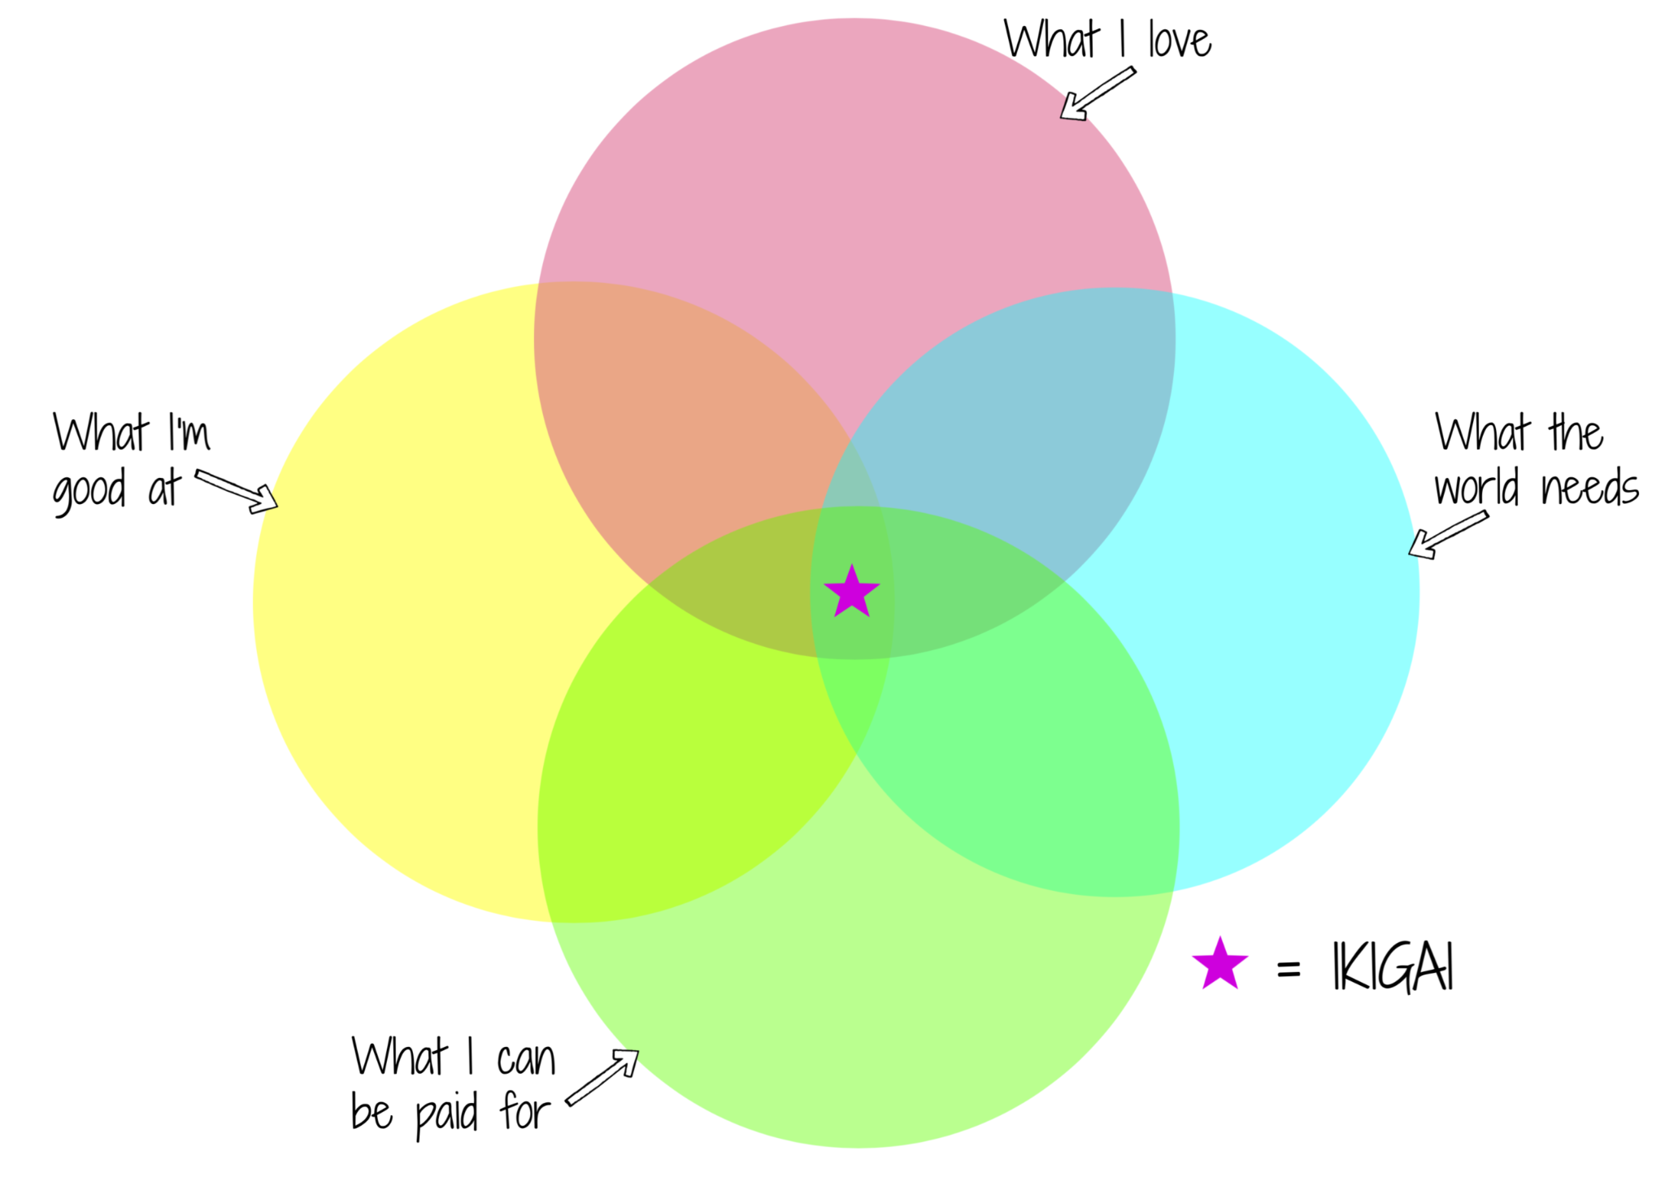
IkiGai
Put everything you have learnt in steps 1 to 4 together and create your own IkiGai ( here.)
.
My target industries
My company culture
My Technologies
Data roles?
Business problems?
My technical Skills
My soft skills
My emerging skills
Roles I can target
Ideal role, industry/domain, Company culture
Notes:
For example, maybe you love to code but do not have enough now to be a data scientist. Could you find a company where it possible to move from data analytics to data science?
Maybe you want to work in finance but have a domain in health.

Slide 12


Follow Up Exercise: Create Your IkiGai
Complete Step 1 What the World Needs of your own IkiGai ( here.)
.
Become knowledgeable about the data roles and their requirements in the marketplace
Watch YouTube Transitional Videos of people of similar background to you who transitioned to data roles.
Join DataTalks.Club where you will find many interviews with people who have transitioned into data.
Join the AI Guild and attend their talks on data roles and transitioning
Notes:
For example, maybe you love to code but do not have enough now to be a data scientist. Could you find a company where it possible to move from data analytics to data science?
Maybe you want to work in finance but have a domain in health.

Slide 13
Create Your IkiGai
Complete Step 1 What the World Needs of your own IkiGai ( here.)
.
Develop a deeper knowledge of how ML or analytics are being used in industries/domains that resonate with you
Read ML Trend Reports , Recruitment Trend Reports and AI User Cases to understand what the world wants
Speak to people who already work in data roles as they already know the answers
Notes:
For example, maybe you love to code but do not have enough now to be a data scientist. Could you find a company where it possible to move from data analytics to data science?
Maybe you want to work in finance but have a domain in health.

Slide 14
Understanding the Roles
Datatalk.club Data Roles Spiced Alum Data Analyst
AI Guide Data Roles Spiced Alum Data Scientist
ML Product Manager Spiced Alum Data Engineer.
Dev Ops RoadMap
Freelancer
Full stack data scientist
Role descriptions
What data roles exist?
Watch YouTube Transitional Videos of people of similar background who transitioned to data roles
How I landed a job as a Product Analyst
From Physics to Machine Learning
From PhD to Data Scientist
From Analytics to Data Science
From Project Management to Data Science
What is the transition like?
Notes:
Mike Cannon-Brookes: How you can use impostor syndrome to your benefit

Slide 15
Business Use for ML & Analytics
Research
ML Trend Reports
Recruitment Trend Reports
AI User Cases
What are the business problems that data solves?
Speak to people who work in data
Attend Data Events and listen and talk to more people
People
Notes:
Mike Cannon-Brookes: How you can use impostor syndrome to your benefit

Slide 16
Let’s look at job roles
Notes:
Poll?

Slide 17
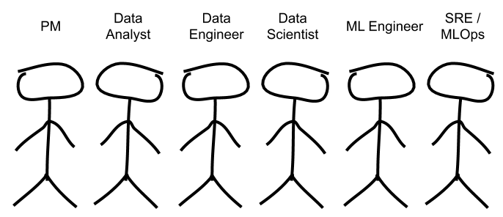
Data Roles
Product Manager
Notes:
Project manager role: Engineering manager or product manager or scrum

Slide 18
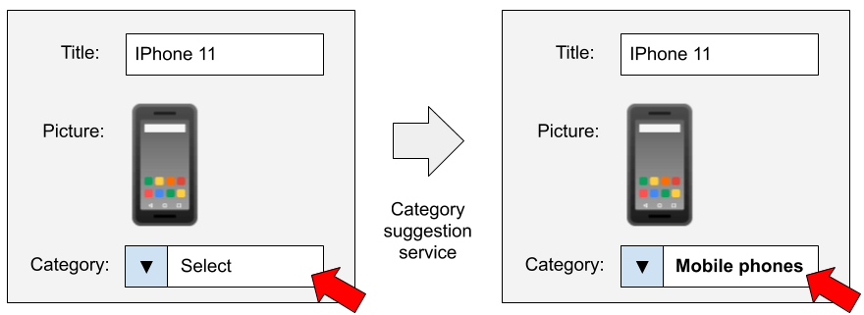
Let’s take an example
“Is this feature that important to the user?”
“Is it an important problem to solve in the product at all?”

Slide 19
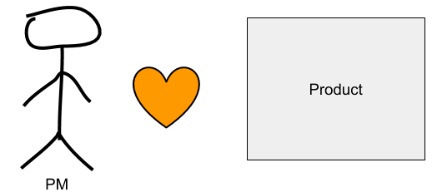
Product Manager
Speaks to the team on behalf of the users.
Has to figure out if users actually need a particular feature, how important this feature is, and if the team has the capacity to implement it. Once implemented evaluates, how it is performing.
Notes:
Questions for discussion:
What’s their primary focus? (They are focusing on the product)
What are the questions they are focusing on? (Is this feature that important? Is this an important problem to solve? What will create business value?)
If you are to hire a PM, what are the key skills, background you will be looking for? (Communication skills, Stakeholders management, Project Management skills, ability to challenge status quo, etc)

Slide 20
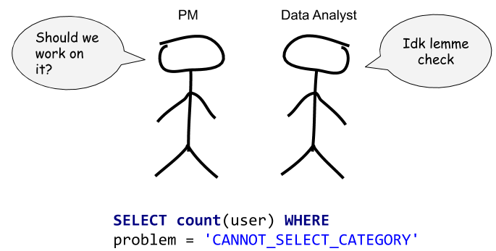
PM & Data Analyst
“How many users are affected by this problem?”
“How many users don’t finish creating their listing because of this problem?”
“How many listings are there on the platform that don’t have the right category selected?”
After the analyst gets the data, analyzes it and answers. “Indeed, this problem is actually worth solving”.
After the model is created, A/B tests to see if more users successfully finish posting an item for sale or if there are fewer ads that end up in the wrong category.

Slide 21
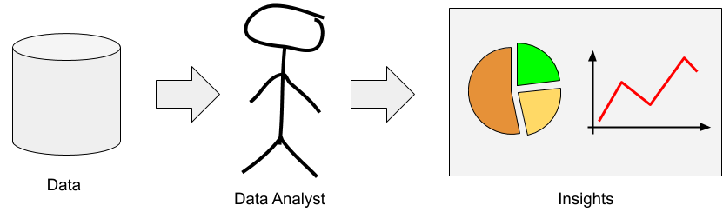
Data Analyst
Defining key metrics
Descriptive rather than predictive analysis.
Running experiments
Building different dashboards
Data manipulation using Python (Pandas)
SQL
Tableau or similar tools for building dashboards
Basics of statistics
Some ML : Linear regression, random forest, time series
Notes:
Questions for discussion:
What are the key questions they are focusing on? (How many users are affected by this problem?What are the key metrics for performance?)
What are DA key skills? (Can we define a minimum here??)
SQL — this is the main tool that they work with;Tableau or similar tools for building dashboards; Basics of statistics; Programming languages such as Python or R (to what extent does it required??);
How to run experiments; a bit of machine learning, such as regression analysis, and time series modeling. Presentation skills, Analytical skills
AI Guild: Skill Descriptive analytics, SQL,statistics, dashboarding and visualization tools
How can DA and Product Manager work together? data analysts help them quantify the extent of the problem.

Slide 22
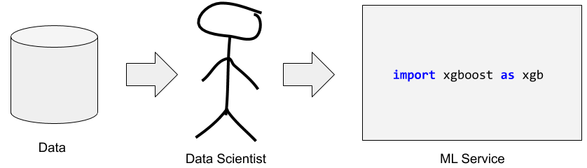
Data Scientist
Exploratory data analysis (similar to data analyst but without the reporting)
Focus on predicting rather than descriptive analysis
Work closely with ML engineers on integrating machine learning services within the product
Machine learning; for building predictive services
Python
SQL
Tensor flow, scikit learn, ETL, docker
Statistics, linear algebra

Slide 23
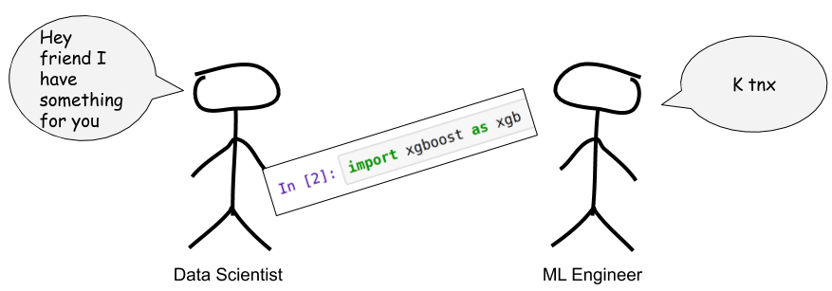
Machine Learning Engineer
Take the trained ML models and make its predictions available to users/system, known as deployment.
Their focus is more on engineering than on modeling.e.g. how frequently predictions should be generated, number of applications that will access the model.
Make sure the code is stable and maintainable.
AWS or Google Cloud;
Infrastructure tools like Kubernetes and Terraform;
Python and other programming languages;
Flask, Docker, and other tools for creating web services.
Notes:
https://www.kdnuggets.com/2020/02/deploy-machine-learning-model.html

Slide 24
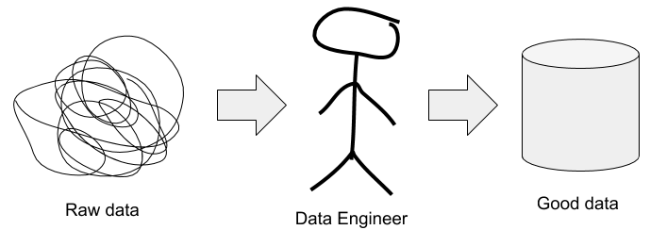
Data Engineer
Data engineers build the data infrastructure
To make the data available for data analysts and data scientist they create “a data lake”
Shortage so demand for data scientists with data engineering skills
AWS or Google Cloud, Spark
Docker, Kubernetes and Terraform; infrastructure tools
Kafka or RabbitMQ; tools for capturing and processing
Airflow or Luigi — for building complex data pipelines.
Python , SQL
Notes:
One more task is to ensure that the people who look at the data have the necessary clearance to do so. Some user data is sensitive and people can’t just go looking around at personal information (such as emails or phone numbers) unless they have a really good reason to do so. Therefore, data engineers need to set up a system that doesn’t let people just access all the data at once.

Slide 25
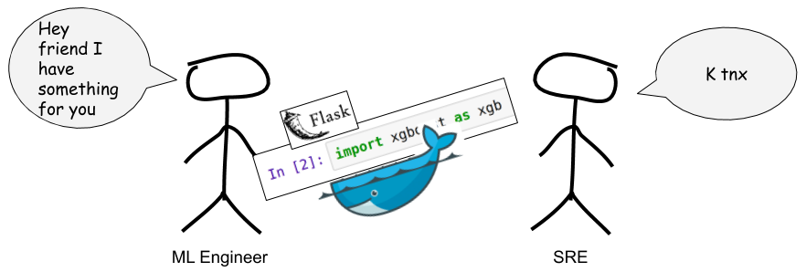
ML Ops Engineer (Site Reliability Engineer)
Focus on infrastructure; networking, servers, CPU usage
Set up alerts to ensure that the data services are up and running
MLOps engineers special type of Dev Ops; know the lifecycle of a ML model
Cloud infrastructure tools
Python
Unix/Linux
Networking
Best DevOps practices like automation; CI/CD

Slide 26

In Groups (8 Minutes)
Exercise
Sort out the tasks into the various data roles.
Your groups answers
Notes:
https://jamboard.google.com/d/1HnJDhPDCA3MTdc6ygy09otcSvwGXxnS8d6Z6z0jD4KE/viewer?f=6 master

Slide 27
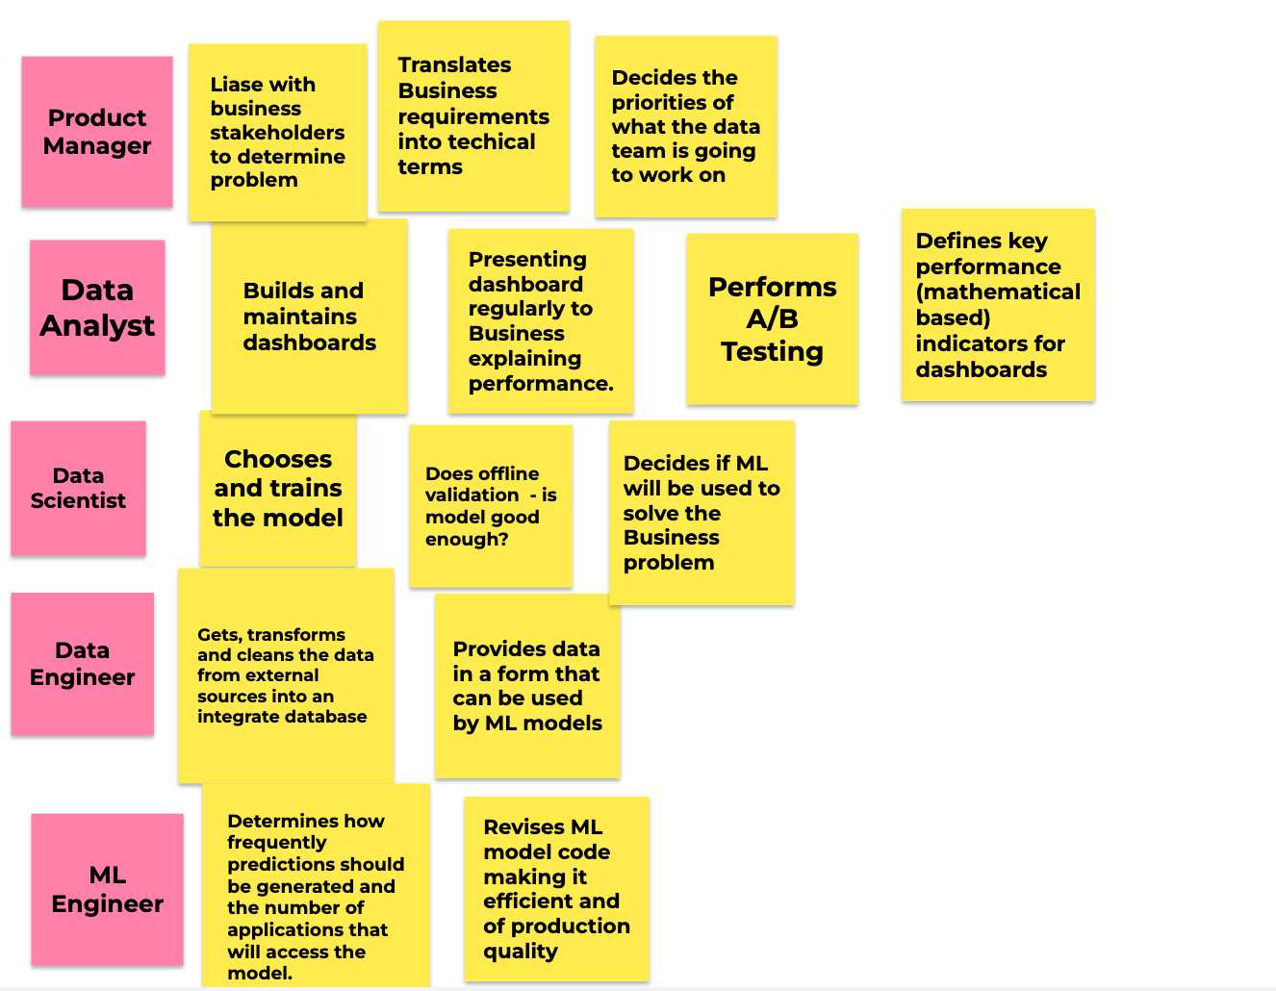
Notes:
CRISP -DM (Cross industry Standard Process for data mining). IT is a framework for organising data science projects.
First step is identify the business problem and how we can solve it. We collect some requirements and translate the requirements into technical terms that the tech team understand. Understand the business and have a view if this problem is worth solve or not and also if we want to use ML to solve it. A measurable goal is set to see if we achieve it or not. 2) Analyse the available data sources and see if we need to get more data.Maybe there is a need to buy some data 3) Once we have the data then we go to the next step which is to transform the data into a form that can be used by a ML algorithm. Getting the data from one source, saving it and then converting it into another form 4) Train the model. Choose the best model and get it as accurate as possible. If you don’t have the features you need, you might go back to the previous step, to get the data you need. Or you might make a new feature out of the features you already have. They can be involved in step 1 to decide if ML should be used to solve the problem. 5) MEasure how well this model when applied working with the real data. So did the model achieve the goal. This is where you do A/B testing. Do a retrospective, what was good , what was bad. They are also involved at in the evaluation stage in deciding if the model should be deployed or should they set a different goal. 6) If the model is good enough then we go to the next stage and deploy our models.Here we can about reliability, maintainability,

Slide 28
Technical Skills Profiles for Data Roles
Data Scientist
Data Analyst
Data Engineer
SQL
Data Architecture
(Unix )
Maths (Linear Algebra & Calculus)
Programming
Data Visualisation
Statistics
Notes:
Title can vary and so can requirements for the roles.
What you can get can depend on how do do your job search?
NLP , self driving cars, image processing, biology. 2 or 3 versions. Data Scientist. Gather data.
Analyst : More interaction with data. Integrity tests. collect in one table. SQL. Extract data, transform it in the dash. Processing
DAta engineer - building scarpers, API from raw sources, cleaning, into data lake.
Statsitcs for data engin. for cleaning.
More python - for data engineer

Slide 29
LinkedIn Figures for Data Roles
Role (Junior) | Aug 2020 Berlin | Jan 2022 Berlin | Aug 2020 Hamburg | Jan 2022 Hamburg | Jan 2022 Cologne
Data Analyst | 66 | 850 | 40 | 470 | 290
Data Scientist | 124 | 550 | 80 | 400 | 140
Data Engineer | 200 | 780 | 100 | 380 | 230

Slide 30
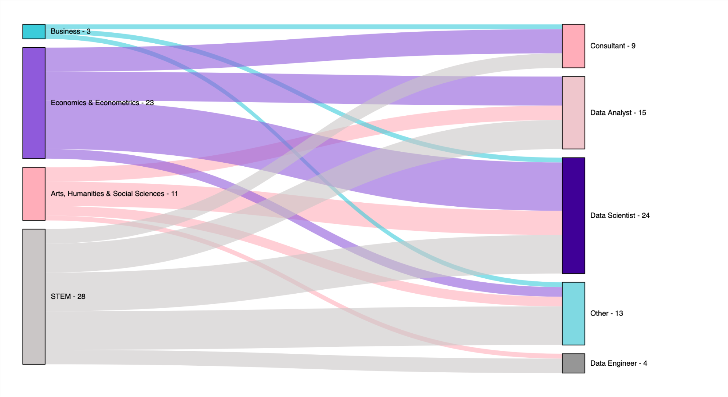
What roles do Spiced Graduates do?
Notes:
consider multiple moves. For data science - consider a 2 step move into it via data analytics
Take your domain knowledge and/or industry knowledge with you helps e.g. structural engineer straight to data science
Why do you think the numbers in Data engineering are low?. significant shortage.ay ask Computer Science/software engineering background. Vet example.

Slide 31
In Groups (2 Minutes)
Exercise
What outstanding questions do you still have regarding roles?
Type your questions into the chat

Slide 32
Follow Up Exercise: Create Your IkiGai
Complete Step 1 What the World Needs of your own IkiGai ( here.)
.
Become knowledgeable about the data roles and their requirements in the marketplace
Watch YouTube Transitional Videos of people of similar background to you who transitioned to data roles.
Join DataTalks.Club where you will find many interviews with people who have transitioned into data.
Join the AI Guild and attend their talks on data roles and transitioning
Notes:
For example, maybe you love to code but do not have enough now to be a data scientist. Could you find a company where it possible to move from data analytics to data science?
Maybe you want to work in finance but have a domain in health.

Slide 33
Follow Up Exercise: Create Your IkiGai
Complete Step 1 What the World Needs of your own IkiGai ( here.)
.
Develop a deeper knowledge of how ML or analytics are being used in industries/domains that resonate with you
Read ML Trend Reports , Recruitment Trend Reports and AI User Cases to understand what the world wants
Speak to people who already work in data roles as they already know the answers
Notes:
For example, maybe you love to code but do not have enough now to be a data scientist. Could you find a company where it possible to move from data analytics to data science?
Maybe you want to work in finance but have a domain in health.

